Slide 1
DEBUGGING PYTHON & HTML CODE OF NOTE TAKING APPLICATION

Slide 2
We have a note taking application with only one route (i.e. Home Route). This Application is broken.
We need to refactor the code and try to make sure that the application works properly.

Slide 3
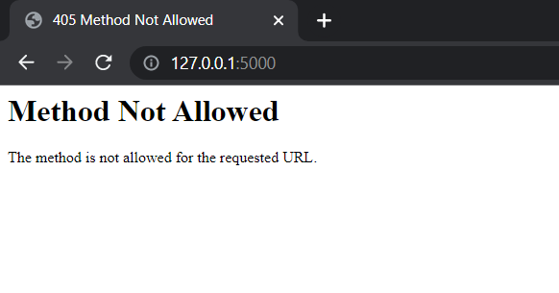
The output gets displayed before debugging the code like this:

Slide 4
CNAGES DONE IN PYTHON CODE:
Here I have added both the ‘GET’ and ‘POST’ request to my route as I wanted the home page to be of GET request and my entered text should be secured so POST request.
Also, The method passed in the route is ‘POST’ and the request to fetch the data from frontend is called as ‘args’ which is used for ‘GET’. So, I changed it to ‘.form’ which is used for ‘POST’.

Slide 5
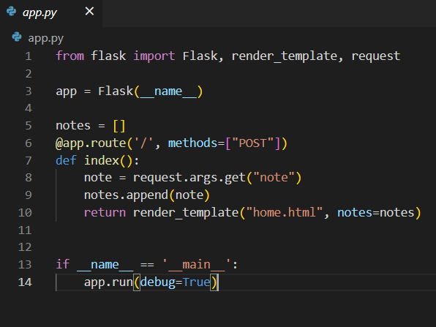
Code Before Debug:

Slide 6
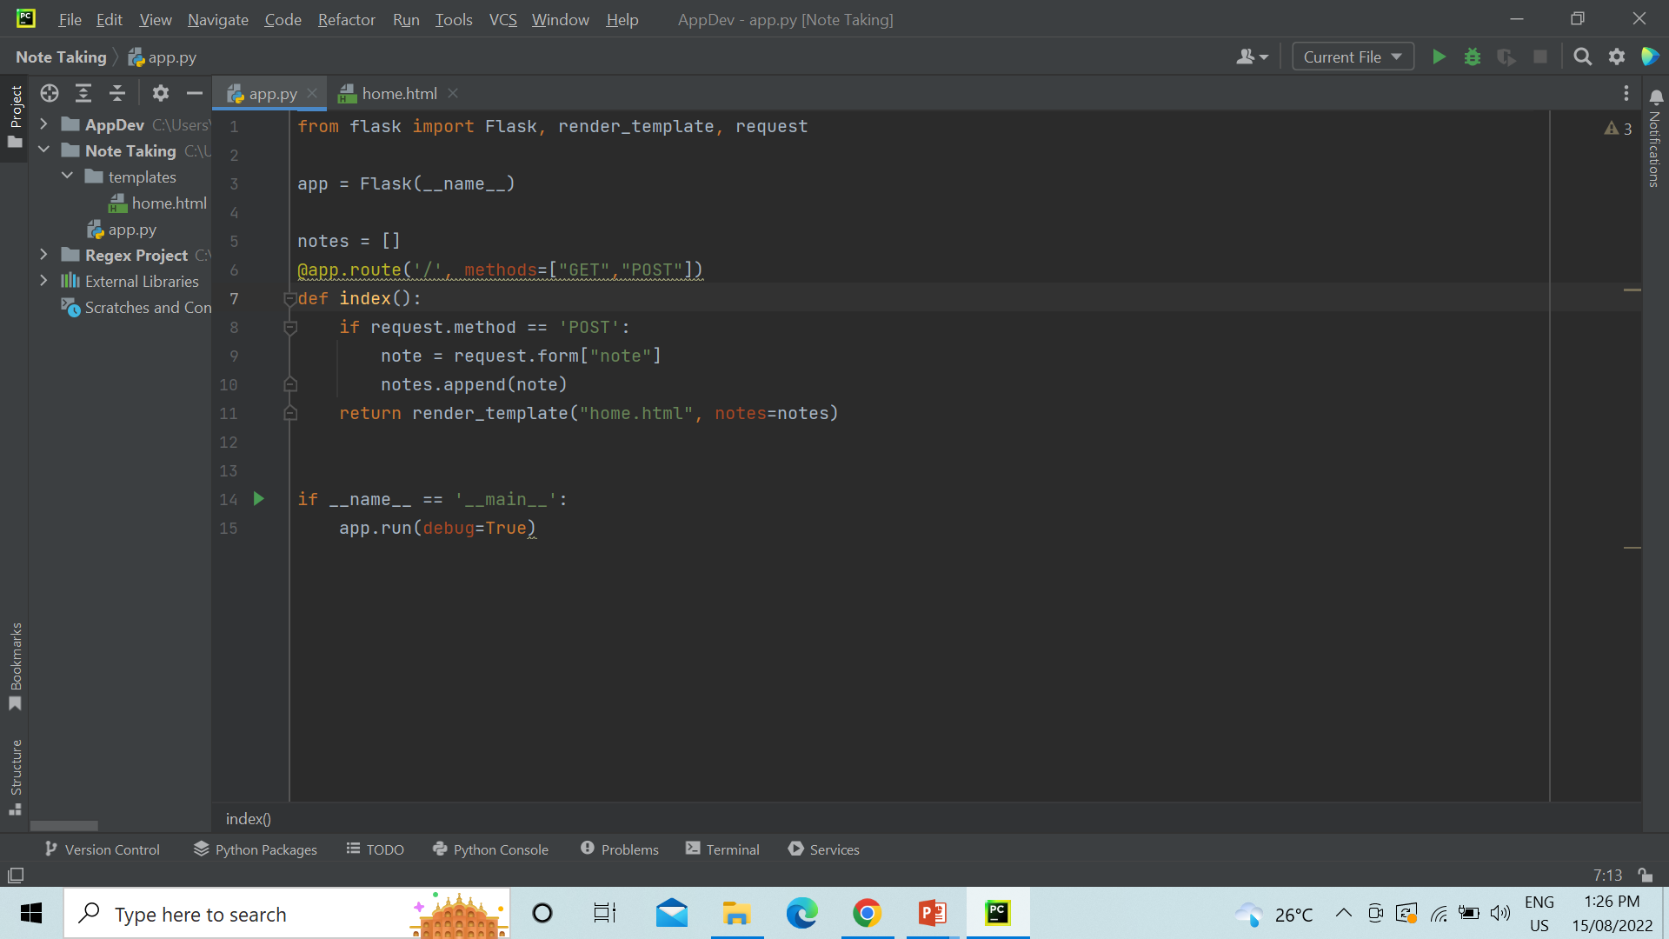
Code After Debug:

Slide 7
Changes Done in the HTML:
The only one change has done in the HTML code that is I have added the method type as ‘post’ next to action as I have wanted the output to get displayed in post request.

Slide 8
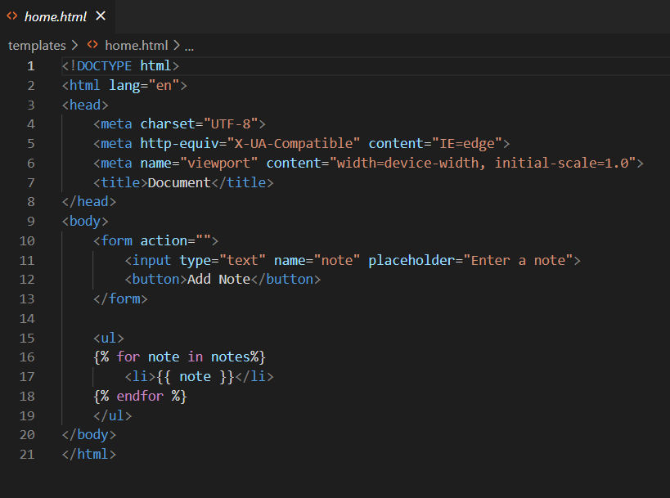
HTML Code Before Debugging:

Slide 9
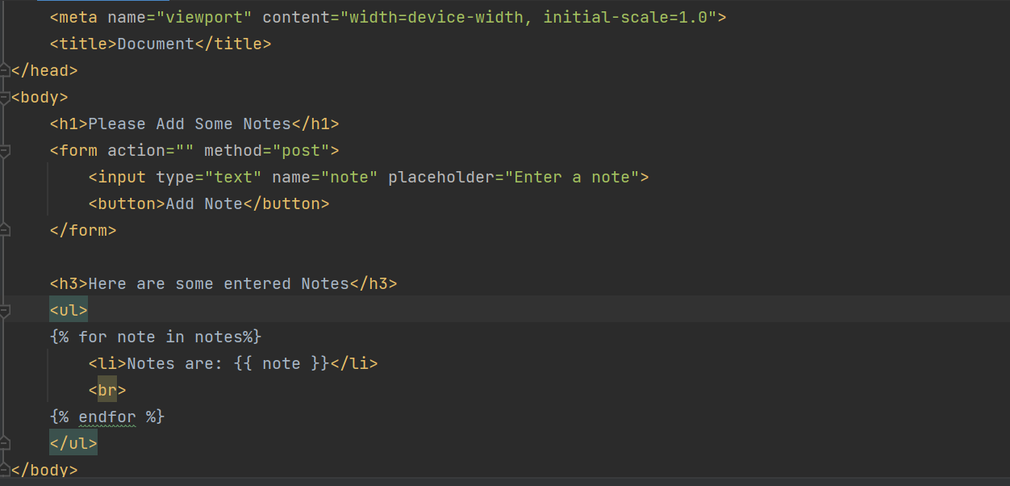
HTML Code After Debugging:

Slide 10
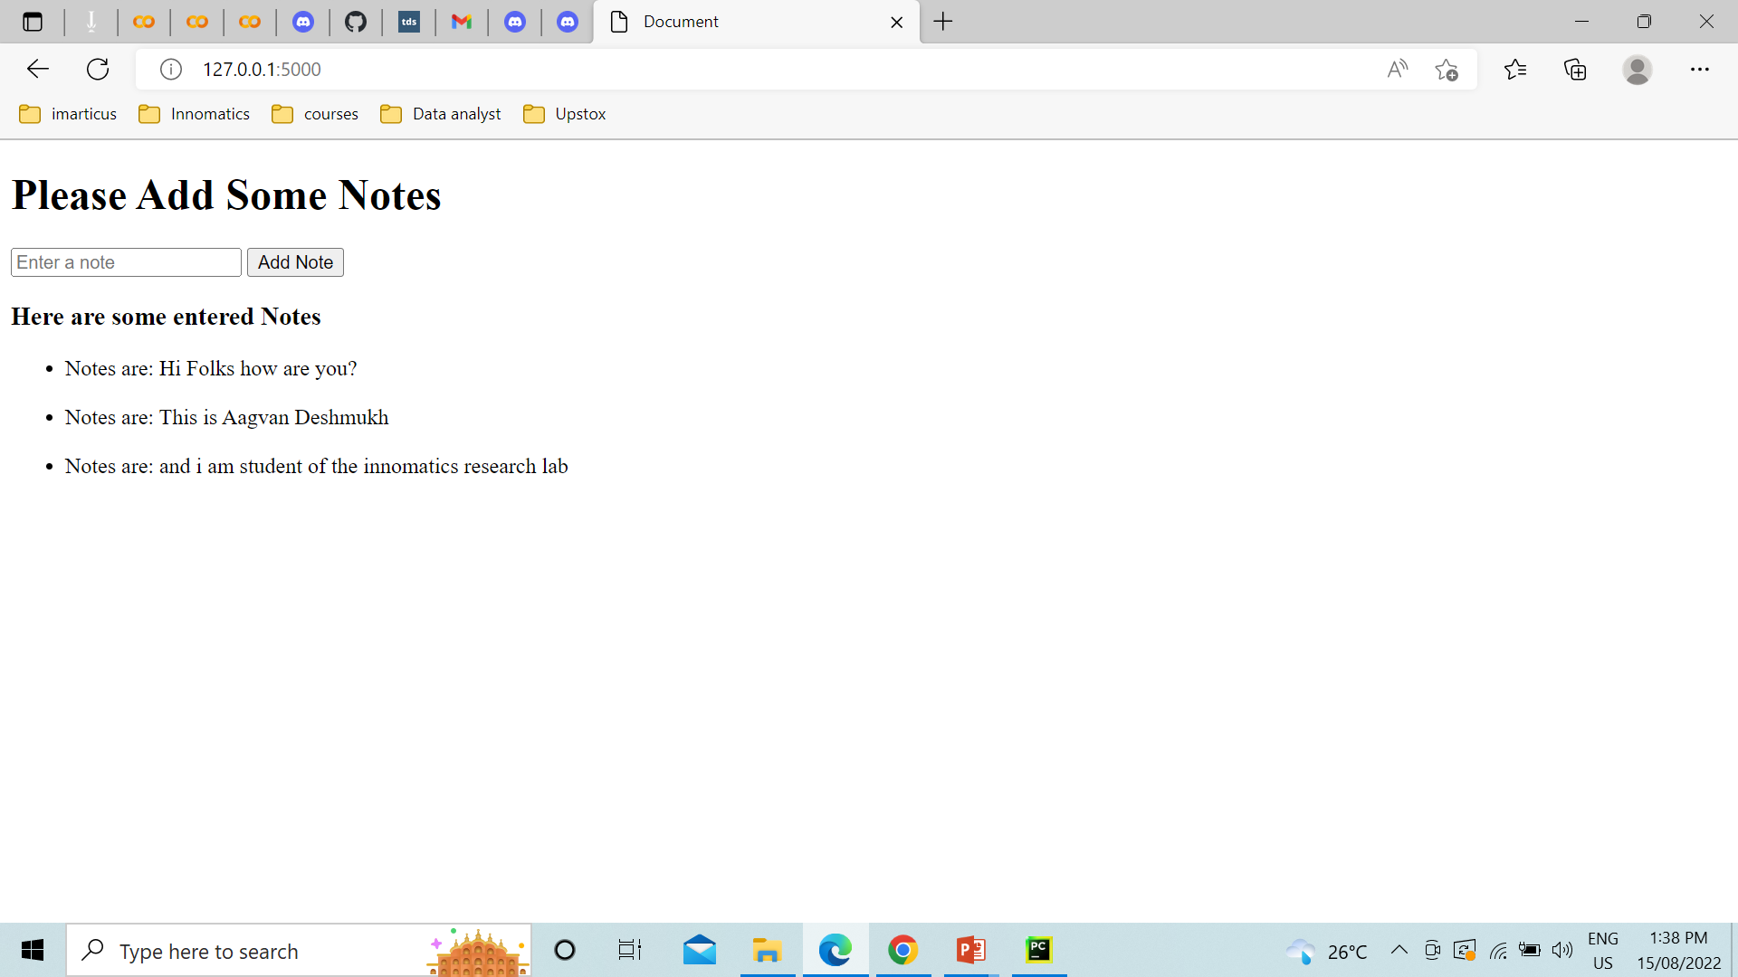
The Application Runs Successfully AFTER DEBUGGING THE CODE:

Slide 11
Thank you!

